Slide 1
JavaScript
DOM document oject model
PHP web development 2019/2020
Milena Tomova
Vratsa Software
https://vratsasoftware.com/

Slide 2
Table of Contents
browser objects
DOM, DOM API
selecting DOM elements
Node, nodes, nodeLists(Live&Static)

Slide 3
browser objects

Slide 4
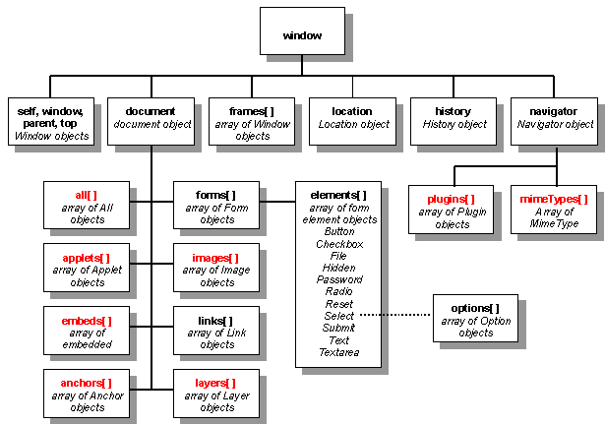
browser objects
window
the browser window
document
the currently open document in the browser
screen
the visual part of the browser
navigator
info about the currents browser

Slide 5
browser objects
document object methods
document.links
document.links[0].href = "yahoo.com";
document.write("This is some <b>bold text</b>");
document.location

Slide 6
DOM

Slide 7

DOM
Document
Object
Model
When a web page is loaded, the browser creates a Document Object Model of the page.
The HTML DOM
model is constructed as a tree
of Objects -
of all the elements
in the document

Slide 8
DOM
The HTML DOM is an Object Model for HTML. It defines:
HTML elements as objects
Properties for all HTML elements
Methods for all HTML elements
Events for all HTML elements
The HTML DOM is an API (Programming Interface) for JavaScript:
JavaScript can add/change/remove HTML elements
JavaScript can add/change/remove HTML attributes
JavaScript can add/change/remove CSS styles
JavaScript can react to HTML events
JavaScript can add/change/remove HTML events

Slide 9
Selecting DOM elements

Slide 10
Selecting ...
Selecting ...
HTML елементите могат да бъдат достъпени и запазени в променливи с помощта на DOM API

Slide 11
Selecting ...
target an html element by id or why id is to be unique
let email_2 = document.getElementById('email_address2');
//returns one element
let span = document.querySelector('#email_form span');
//returns the first element of that selector

Slide 12
Selecting ...
targeting a group of html elements
let inputs = document.getElementsByTagName('input');
let email = document.getElementsByName('email_address2');
let classGroup = document.getElementsByClassName('className');
let formInputs = document.querySelectorAll('#email_form input');
//all of that selector

Slide 13
Selecting ...
targeting with methods for a type of elements
let body = document.body;
let links = document.links; //all the links elements in a
document
let forms = documents.forms; //all the form elements
let form = documents.forms[2] //third form in the forms
collection

Slide 14
Selecting ...
selecting nested elements
<div id="wrapper">
<div>Divs in wrapper</div>
<div>Divs in wrapper</div>
</div>
var wrapper = document.getElementById('wrapper');
var divsInWrapper = wrapper.getElementsByTagName('div');

Slide 15
Selecting ...
selecting nested elements
<div id="wrapper">
<div>Divs in wrapper</div>
<div>Divs in wrapper</div>
</div>
var divsInWrapper = wrapper.querySelectorAll('.wrapper div');

Slide 16
Selecting ...
Return a single element
getElementById()
querySelector(‘selector’)
Return a collection of elements
getElementsByTagName('tag name');
getElementsByName('name');
getElementsByClassName('className');
querySelectorAll(‘selector’)

Slide 17
Node, Nodes, Nodes List

Slide 18
Node, Nodes, Nodes List
Node,
Nodes,
Nodes List
NodeList - elements/collection returned by
the DOM API method -
getElementsByTagName(tagName)
getElementsByName(name)
getElementsByClassName(className)
querySelectorAll(selector)

Slide 19
Node, Nodes, Nodes List
Node,
Nodes,
Nodes List
NodeList is a JavaScript Object
has
length property
index for every node in the list

Slide 20
Node, Nodes, Nodes List
Node,
Nodes,
Nodes List
There are -
live node lists
returned by the getElementsBy methods
static node lists
returned by the querySellector methods

Slide 21
Node, Nodes, Nodes List
Node,
Nodes,
Nodes List
live node list
watches for changes in its nodes and reflects them
static node list
doesn`t change the data for its nodes if they
have been changed

Slide 24



Trainings @ Vratsa Software
Vratsa Software – High-Quality Education, Profession and Jobs
www.vratsasoftware.com
The Nest Coworking
www.nest.bg
Vratsa Software @ Facebook
www.fb.com/VratsaSoftware
Slack Channel
www.vso.slack.com

